Slide 1

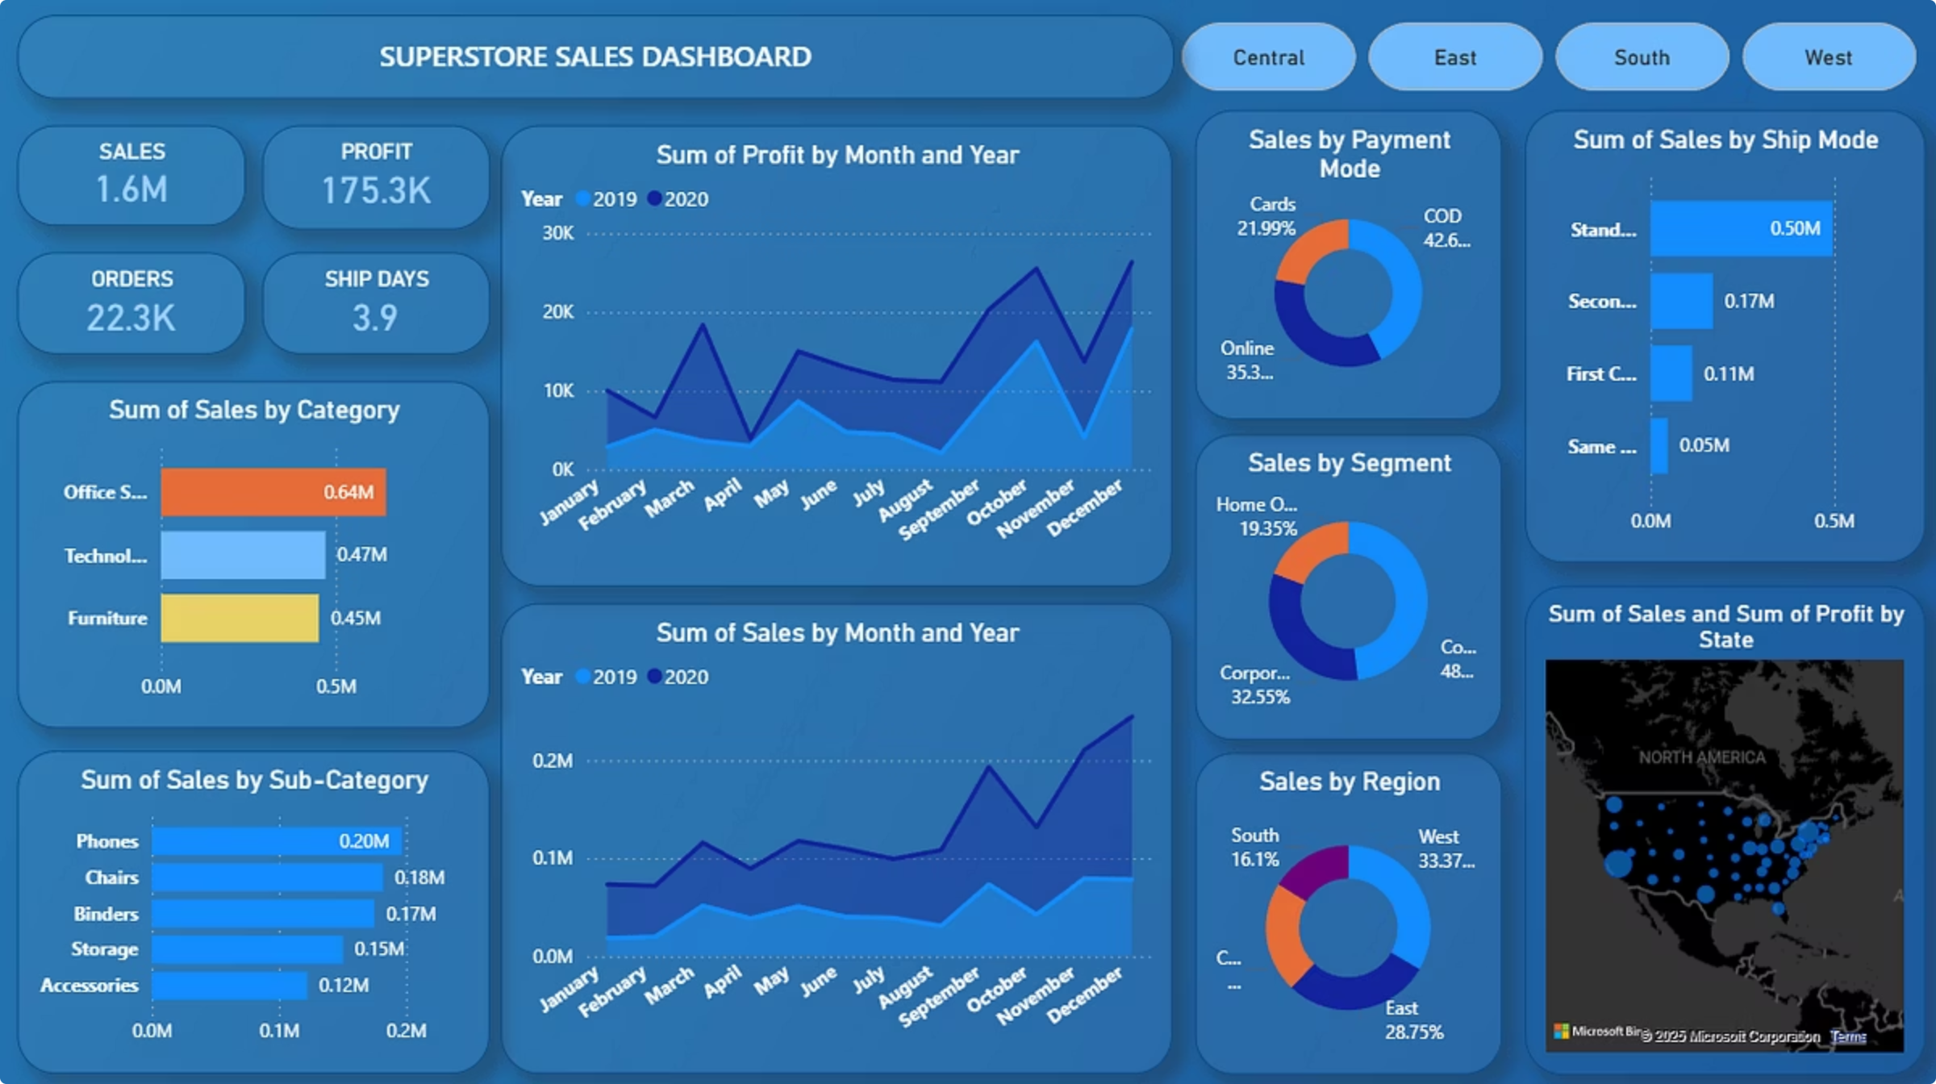
Superstore Sales Dashboard
Task 3 – Data Analytics
Presented by: M ABDUL RAMEEZ

Slide 2
Objective
Create an interactive sales dashboard using Power BI.
Analyze Superstore sales data across various dimensions.
Present insights through dynamic visualizations.

Slide 3

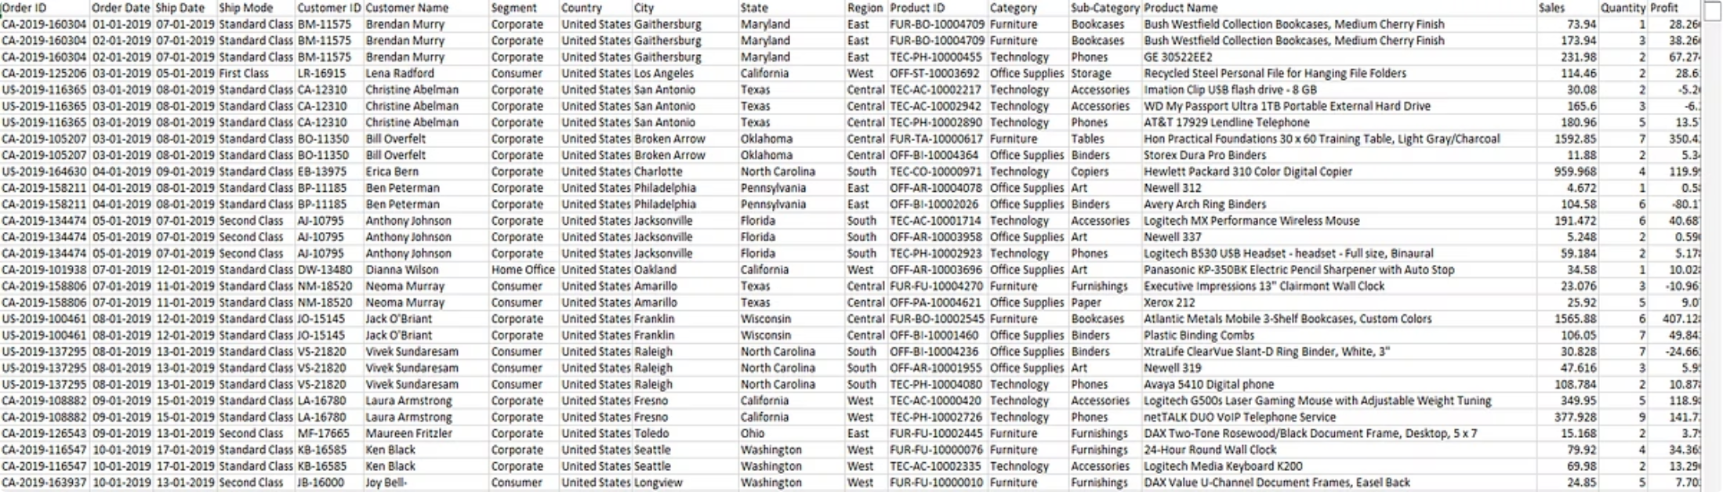
Dataset Overview
Source
Fields Used
- Superstore sales dataset.csv
Sales, Profit, Orders, Ship Days
Category, Sub-Category, Segment, Region, State
Ship Mode, Payment Mode
Order Date, Ship Date

Slide 4




Key KPIs Displayed
Total Sales
Total Profit
Total Orders
Average Shipping Days

Slide 5
Dashboard Features
Region-wise filter buttons: Central, East, South, West
Donut charts:
Sales by payment mode
Line charts showing sales and profit trends by month/year
Sales by segment
Sales by region
Bar charts:
Map Visualization: Sales & Profit by state
Sales by category and sub-category
Sales by ship mode

Slide 6
Insights & Observations
Best Performing Categories
Shipping Trends
Customer Segments
Office Supplies had the highest sales (~0.64M), especially in the Central and East regions.
Standard Class is the most used shipping mode, contributing over 0.5M in sales.
The Consumer segment leads across all regions, followed by Corporate and Home Office.
Technology delivered the highest profit margins, notably in the West.
Same Day and First Class are used less frequently but consistently available.
Consumer-focused strategies can yield higher engagement and sales.
Furniture had lower profit-to-sales ratios, possibly due to higher costs or discounts.
Sales Over Time
Payment Preferences
Sales and profits spike in Q4 (Oct–Dec) each year.
Cash on Delivery (COD) is most common (~42%), followed by Online and Card payments.
Slight dips occur between April–June, possibly due to seasonal slowdowns or increased discounts.
There’s scope to promote digital payments through offers or rewards.

Slide 7

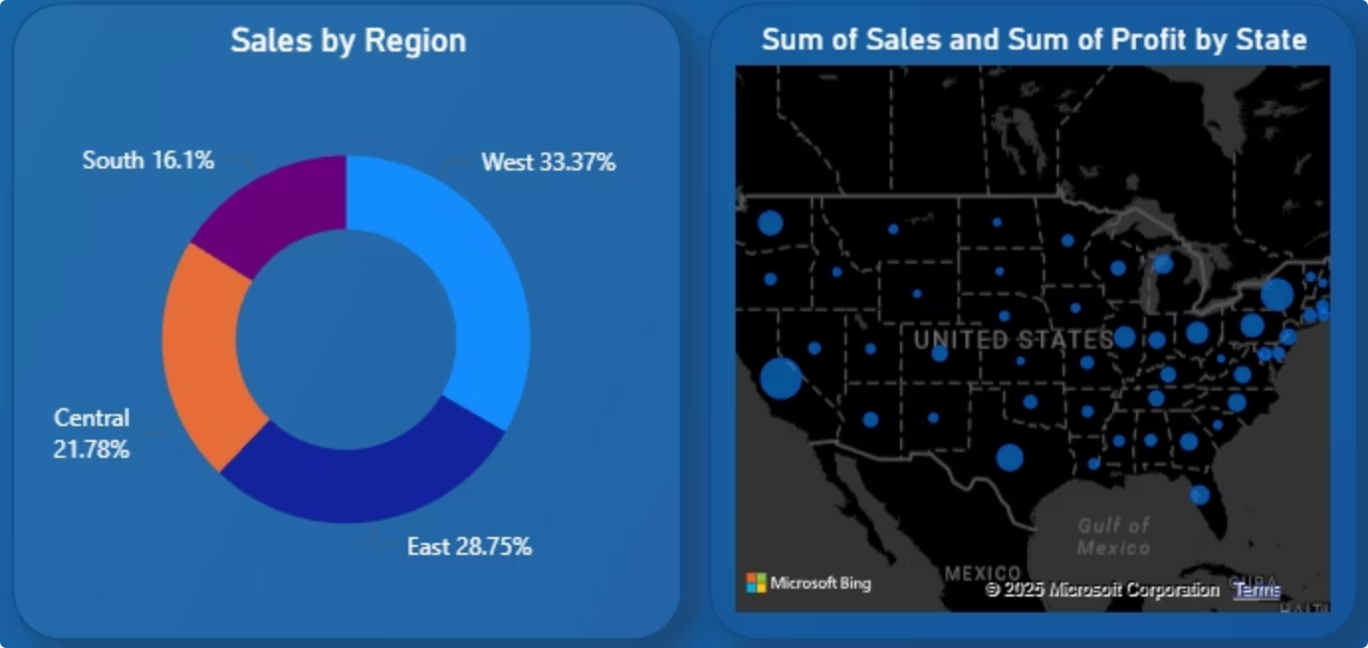
Regional Drill-Down
Central Region
South Region
Sales ~341K
Sales ~252K, Profit ~26K
Top categories: Office Supplies, Furniture
Phones and Tables lead in sales
Profit increases in March and September
Preferred ship mode: Standard Class
Lower performance in October
Sub-categories: Chairs, Phones, Binders
West Region
East Region
Highest Sales (~522K) and Profit (~67K)
Best performance in Technology and Office Supplies
Sales ~450K, Profit ~53K
Strong in Office Supplies and Technology
Sub-categories: Phones, Chairs, Binders
Balanced payment mode usage (COD, Online, Card)
Strong and stable Q4 performance
Performance dips in August, peaks in Q4

Slide 8

Conclusion
Summary
Insights
The Power BI dashboard offers interactive, region-wise sales analysis using Superstore data. Key business metrics like sales, profit, quantity, and discount are visualized for quick decision-making.
Office Supplies are top sellers, while Technology products are most profitable.
December shows consistent sales peaks — critical for planning promotions.
West Region leads in revenue and should be a focus for expansion.
Phones, Chairs, and Binders are the most successful sub-categories.

